Slide 1
CS422 Database systems
Data Storage
Data-Intensive Applications and Systems (DIAS) Laboratory École Polytechnique Fédérale de Lausanne
“It is better to have 100 functions operate on one data structure than to have 10 functions operate on 10 data structures” – Alan Perlis
Some slides adapted from:
Andy Pavlo
CS-322

Slide 2

(Simplified) DBMS Architecture
Application Front Ends
Web Forms
SQL Interface
Memory
SQL Commands
Parser + Optimizer +
Plan Execution
Transaction
Manager
Recovery
Manager
Files and Access Methods
Buffer Management
Storage Management
Disk
Data

Slide 3
Today’s topic
Buffer Management
Storage Management
Data

Slide 4
Storage Hierarchy
Faster Smaller
CPU Registers
CPU Caches
DRAM
SSD
HDD
Slower Larger
Network Storage

Slide 5
Access Times
Faster Smaller
CPU Registers
L1: 0.5 ns
CPU Caches
L2: 7 ns
100 ns
DRAM
150,000 ns
SSD
10,000,000 ns
HDD
Slower Larger
~30,000,000 ns
Network Storage

Slide 6
Goals
Allow the DBMS to manage databases that exceed the amount of memory available
Try to have the working set in main memory
Try to reuse data placed in topmost layers as much as possible

Slide 7


Outline
Page
Students
sid | name | login | age | gpa
50000 | Dave | dave@cs | 19 | 3.3
53666 | Jones | jones@cs | 18 | 3.4
53688 | Smith | smit@ee | 18 | 3.2
… | … | … | … | …
Fields
Records/ Tuples
…
Files
…
…
File
Storage
Pages
Notes:
File: A collection of pages
Page: A collection of records
Record: A sequence of fields

Slide 8
Outline
File Storage
Page Layout
Buffer Management

Slide 9
File Storage
The DBMS stores a database as one or more files on disk.
The Storage Manager is responsible for maintaining a database’s files, and organizes them as a collection of pages.
Tracks data read/written to pages
Tracks available space

Slide 10
Alternative File Organizations
Many alternatives exist, each good for some situations, and not so good in others. A non-exhaustive list is the following:
Heap files: Suitable when typical access is a file scan retrieving all records.
Sorted Files: Best for retrieval in some order, or for retrieving a ‘range’ of records.

Slide 11
Heap (Unordered) Files
Simplest file structure
contains records in no particular order
Need to be able to scan, search based on rid
As file grows and shrinks, disk pages are allocated and de-allocated.
Need to manage free space

Slide 12
Heap File Implemented Using Lists
Data
Page
Data
Page
Data
Page
…
Full Pages
Header
Page
Data
Page
Data
Page
Data
Page
…
Pages with
Free Space
<Heap file name, header page id> stored somewhere
Each page contains 2 ‘pointers’ plus data.
Manage free pages using free list
What if most pages have some space?

Slide 13
Heap File Using a Page Directory
Data
Page 1
Header
Page
Data
Page 2
…
Data
Page N
DIRECTORY
The directory is a collection of pages
linked list implementation is just one alternative.
The entry for a page can include the number of free bytes on the page.
Much smaller than linked list of all HF pages!

Slide 14
Outline
File Storage
Page Layout
NSM, aka row-oriented
Buffer Management
Notes:
This discussion does not apply to the log-structured organization

Slide 15
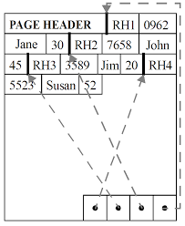
The N-ary Storage Model
Page = collection of slots
Each slot stores one record
Record identifier: <page_id, slot_number>
Option 2: <uniq> -> <page_id, slot_number>
Page format should support
Fast searching, inserting, deleting
Page format depends on record format
Fixed-Length
Variable-Length

Slide 16
Record Formats: Fixed-Length
F1
F2
F3
F4
L1
L2
L3
L4
Base address (B)
Address = B+L1+L2
Schema is stored in system catalog
Number of fields is fixed for all records of a table
Domain is fixed for all records of a table
Each field has fixed length
Finding i^{th} field is done via arithmetic.

Slide 17
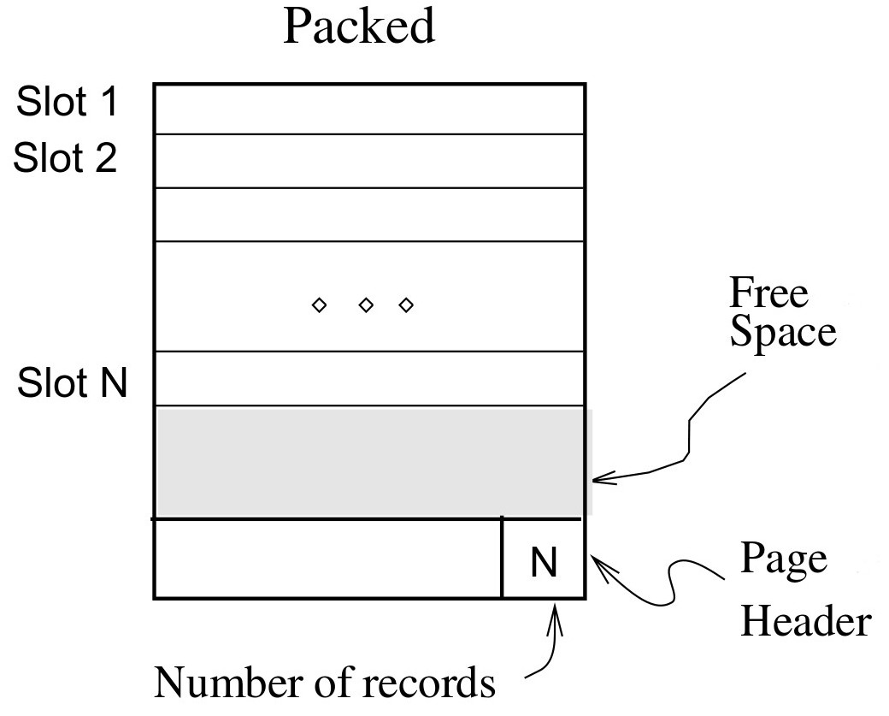
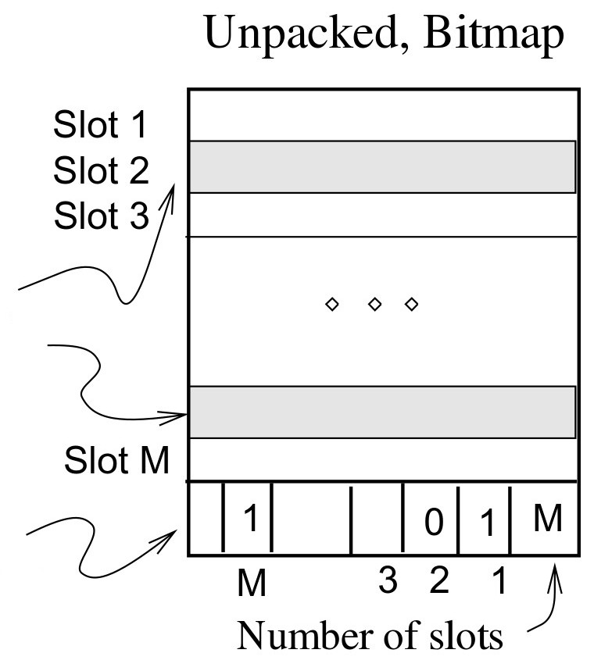
Page Format: Fixed-Length Records
Record id = <page id, slot #>
In the packed case, moving records for free space management changes rid; maybe unacceptable.

Slide 18
Record Formats: Variable-Length
F1 F2 F3 F4
$
$
$
$
Fields Delimited by Special Symbols
F1 F2 F3 F4
Array of Field Offsets
Array of field offsets is typically superior
Direct access to fields
Clean way of handling NULL values
Oracle 8: length—data pairs, DB2: Array of offsets

Slide 19
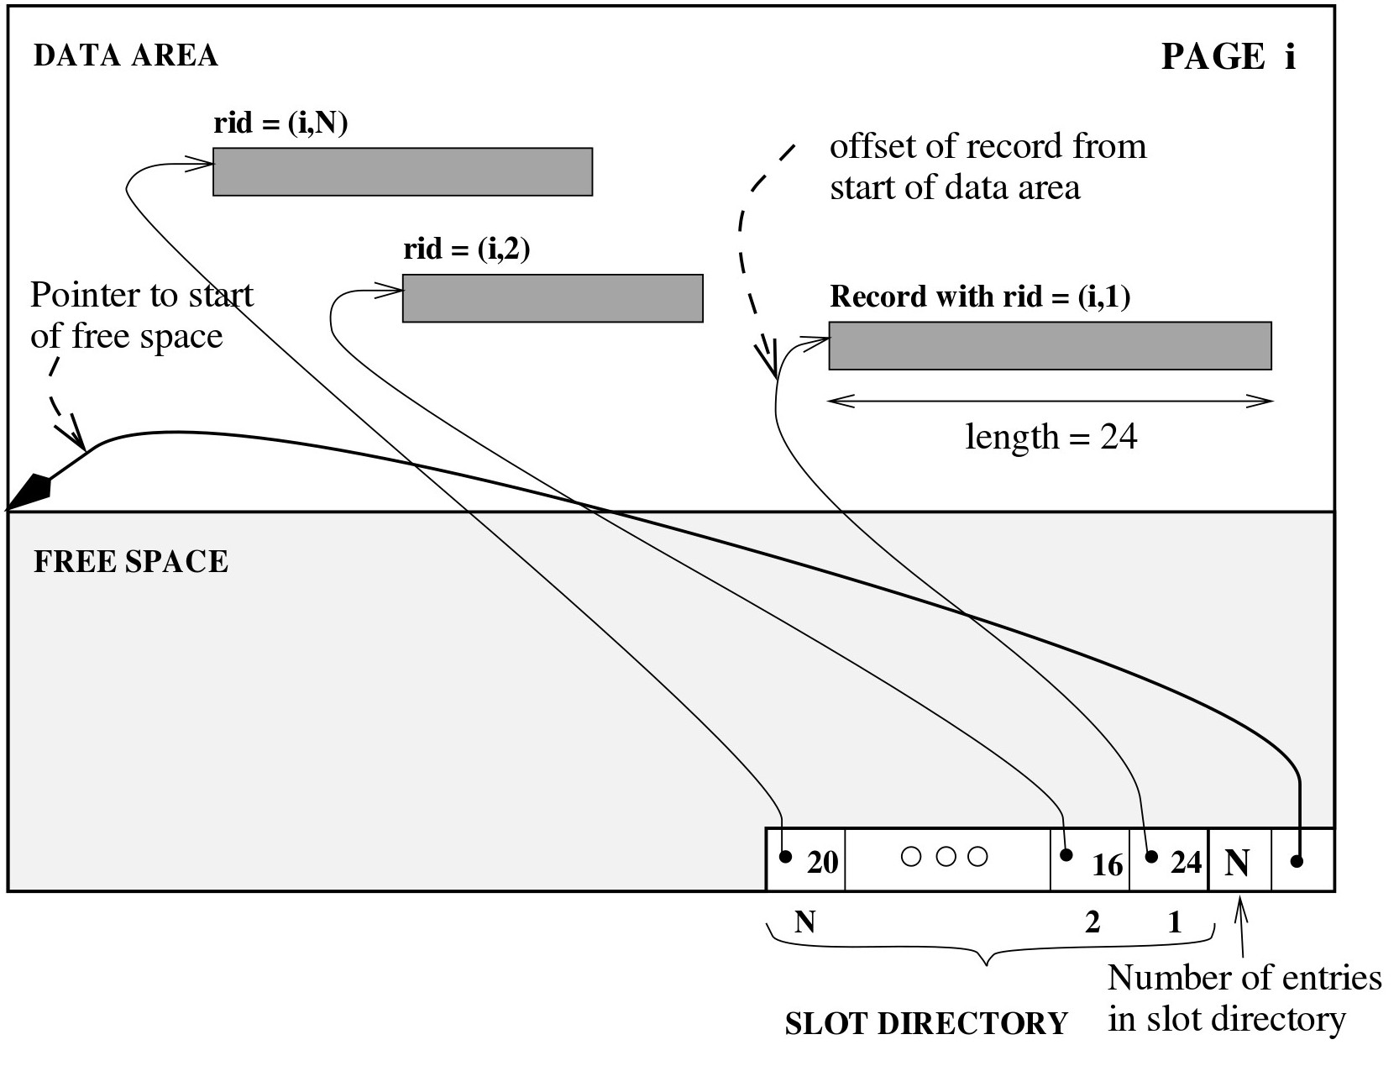
Page Format: Variable-Length Records
Data
Slot Array
Need to move records in a page
Allocation/deletion must find/release free space
Maintain slot directory with <record offset, record length> pairs
Records can move on page without changing rid
Useful for freely moving fixed-length records (ex: sorting)

Slide 20
Variable-Length Records: Issues
If a field grows and no longer fits?
shift all subsequent fields
If record no longer fits in page?
Move a record to another page after modification
What if record size > page size?
SQL Server record size = 8KB
DB2 record size = page size

Slide 21
Outline
File Storage
Page Layout
NSM, aka row-oriented
Buffer Management
Notes:
This discussion does not apply to the log-structured organization

Slide 22
Can’t we just use the OS buffering?
Layers of abstraction are good … but:
Unfortunately, OS often gets in the way of DBMS
DBMS needs to do things “its own way”
Specialized prefetching
Control over buffer replacement policy
LRU not always best (sometimes worst!!)
Control over thread/process scheduling
“Convoy problem”
Arises when OS scheduling conflicts with DBMS locking
Control over flushing data to disk
WAL protocol requires flushing log entries to disk

Slide 23
Buffer Management in a DBMS
Page Requests from Higher Levels
Data must be in RAM for DBMS to operate on it!
Buffer manager hides the fact that not all data is in RAM (just like hardware cache policies hide the fact that not all data is in the caches)
BUFFER POOL
disk page
free frame
MAIN MEMORY
DISK
choice of frame dictated
by replacement policy
DB

Slide 24
When a Page is Requested ...
Buffer pool information table contains: <frame#, pageid, pin_count, dirty>
If requested page is not in pool:
Choose a frame for replacement (only un-pinned pages are candidates)
If frame is “dirty”, write it to disk
Read requested page into chosen frame
Pin the page and return its address.
If requests can be predicted (e.g., sequential scans)
pages can be pre-fetched several pages at a time!

Slide 25
More on Buffer Management
Requestor of page must unpin it, and indicate whether page has been modified:
dirty bit is used for this.
Page in pool may be requested many times,
a pin count is used. A page is a candidate for replacement iff pin count = 0 (“unpinned”)
CC & recovery may entail additional I/O when a frame is chosen for replacement
Notes:
. (Write-Ahead Log protocol; more later.)

Slide 26
Buffer Replacement Policy
Frame is chosen for replacement by a replacement policy:
Least-recently-used (LRU), MRU, Clock, etc.
Policy can have big impact on # of I/O’s; depends on the access pattern.

Slide 27
LRU Replacement Policy
Least Recently Used (LRU)
for each page in buffer pool, keep track of time last unpinned
replace the frame which has the oldest (earliest) time
very common policy: intuitive and simple
Problems?
Problem: Sequential flooding
LRU + repeated sequential scans.
# buffer frames < # pages in file means each page request causes an I/O. MRU much better in this situation (but not in all situations, of course).

Slide 28
Sequential Flooding – Illustration
BUFFER POOL
LRU:
BUFFER POOL
MRU:
1
2
3
4
5
6
7
8
Repeated scan of file …

Slide 29
“Clock” Replacement Policy
A(1)
An approximation of LRU.
Arrange frames into a cycle, store
one “reference bit” per frame
When pin count goes to 0, reference bit set on.
When replacement necessary:
do {
if (pincount == 0 && ref bit is off)
choose current page for replacement;
else if (pincount == 0 && ref bit is on)
turn off ref bit;
advance current frame;
} until a page is chosen for replacement;
B(p)
D(0)
C(1)

Slide 30


Slide 31
Outline
File Storage
Log-structured
Page Layout
NSM, aka row-oriented
DSM, aka column-oriented
Buffer Management
Notes:
This discussion does not apply to the log-structured organization

Slide 32
The database as the log
Many alternatives exist, each good for some situations, and not so good in others. A non-exhaustive list is the following:
Heap files: Suitable when typical access is a file scan retrieving all records.
Sorted Files: Best for retrieval in some order, or for retrieving a ‘range’ of records.
Log-structured Files: Best for very fast insertions/deletions/updates

Slide 33
Log-structured files
Instead of storings tuples in pages, the DBMS only stores log records.
The system appends log records to the files of how the database was modified.
Inserts: Store the entire tuple
Deletes: Mark tuple as deleted
Updates: Store delta of just the attributes that were modified

Slide 34
Writing to log-structured files
Inserts: Store the entire tuple
Deletes: Mark tuple as deleted
Updates: Store delta of just the attributes that were modified

Slide 35
Reading from log-structured files
DBMS scans log backwards, and “recreates” the tuple

Slide 36
Reading from log-structured files
DBMS scans log backwards, and “recreates” the tuple
Build indexes to allow jumps in the log
Periodically compact the log

Slide 37
Outline
File Storage
Page Layout
NSM, aka row-oriented
DSM, aka column-oriented
Buffer Management
Notes:
This discussion does not apply to the log-structured organization

Slide 38
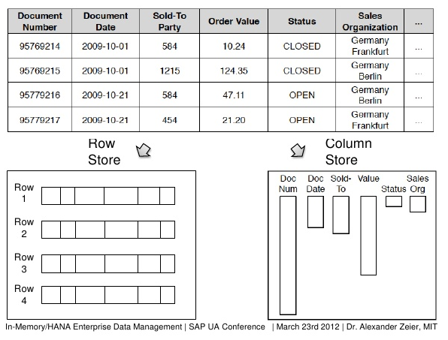
Decomposition Storage Model (DSM)

Slide 39
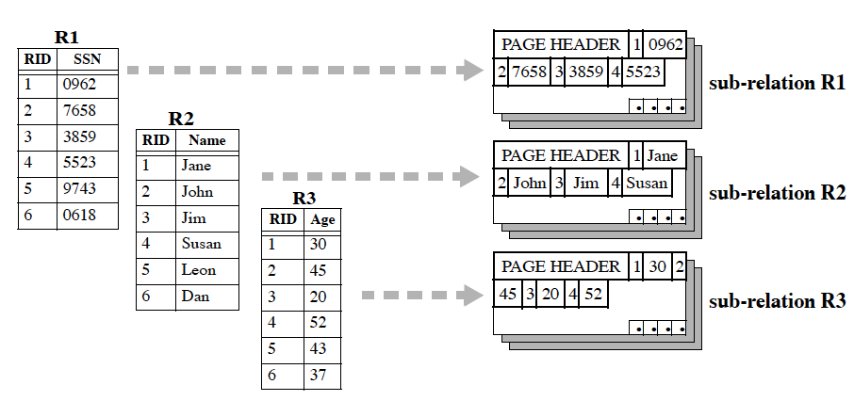
DSM Page Format
Decompose a relational table to sub-tables per attribute
Notes:
Joins & transactions

Slide 40
Columnar storage example
tbl1
Columns stored in pages
Denoted with different colors
Each column can be accessed individually
Pages loaded only for the desired attributes
Name
John
Jack
Jane
Georg
Wolf
Maria
Andy
Ross
Jack
Age
22
19
37
43
51
23
56
22
63
Dept
HR
HR
IT
FIN
IT
HR
FIN
SALES
FIN
Three different files: tbl1.name tbl1.age tbl1.dept
Notes:
Storage of column stores: each column stored in a different file. Data broken to pages. Pages denoted with different colours here.

Slide 41
DSM Properties
Pros:
Saves IO by bringing only the relevant attributes
(Very) memory- and CPU-friendly
Compressing columns is typically easier

Slide 42
Compression
Lossless compression
IO reduction → less CPU wait time
Introduces small additional CPU load on otherwise idle CPU
Run-length encoding (RLE)
Dept
HR
HR
SALES
IT
IT
CDept
(2 x HR)
(1 x SALES)
(2 x IT)

Slide 43
Compression (2)
Bit-vector encoding
Useful when we have categorical data
One bit vector for each distinct value
Useful when a few distinct values
Vector length = # elements
Dept
HR
HR
SALES
IT
IT
HR: 11000
SALES: 00100
IT: 00011
Notes:
Bit vector encoding when we have categorical data

Slide 44
Compression (3)
Dictionary encoding
Replace long values (e.g., strings) with integers
Useful when a few distinct values
Dept
HR
IT
HR
SALES
HR
FINANCE
FINANCE
IT
CDept
1
2
1
3
1
4
4
2
Dictionary
1 | HR
2 | IT
3 | SALES
4 | FINANCE
Notes:
Dictionary encoding to avoid long, costly values.
Think of replacing school names, or departments, with integers. For example “Electrical Engineering and Computer Science, Massachusetts Institute of Technology” (~90 bytes) to 4 bytes. This can speed up loading and reduce memory requirements a lot. The real text will be loaded only at the end, and only if it is finally needed.

Slide 45
Compression
Smaller dictionaries improve |  | - memory requirements - cache utilization - effectiveness of run-length encoding
Frequency partitioning
Reorganize each column to reduce entropy at each page
Dept
HR
IT
FIN
FIN
HR
HR
FIN
HR
SALES
Dept
1 | HR
5 | HR
6 | HR
8 | HR
2 | IT
3 | FIN
4 | FIN
7 | FIN
9 | SALES
CDept
1 | 1
5 | 1
6 | 1
8 | 1
2 | 1
3 | 2
4 | 2
7 | 2
9 | 1
Column
reorganization
Dictionary-based
compression
with per-page
dictionaries
Notes:
To enable better compression, reorder entities within each column and use explicit ids. This can be achieved through external sorting. Then build per-page dictionaries.
This will enable shorter values as dictionary pointers, e.g., short instead of integer → reduce memory and IO, increase cache utilization.
Frequency partitioning also increases effectiveness of run-length encoding!

Slide 46
Operators over compressed data
No need to decompress for most query operators
Dictionary encoding => integer comparisons faster than string comparisons
SELECT name FROM tbl WHERE DEPT=“HR”
vs SELECT name FROM tbl WHERE CDEPT=1
Per-page dictionaries?
Run-length encoding → batch processing
Bit-vector encoding → find the ones directly from the bit vectors
SELECT COUNT(*) FROM tbl WHERE CDEPT=“HR”
Notes:
Integer comparisons (e.g., equality and range queries)
Operators that we can execute on compressed data: equality checks & comparisons, joins, group bys
Per-page dictionaries more difficult. We cannot build an index based on per-page dictionaries!

Slide 47
DSM Properties
Pros:
Saves IO by bringing only the relevant attributes
(Very) memory- and CPU-friendly
Compressing columns is typically easier
Cons:
Writes more expensive
Have to materialize relations at some point

Slide 48
Column stores: Writes
tbl1
Row insertions/deletions
Affects all columns
Multiple I/Os
Complicated transactions
Deletes/updates: Implicit
Mark record as deleted!
Massive data loading: Write-optimized storage (WOS)
Name
John
Jack
Jane
Age
22
19
37
Dept
HR
HR
IT
Notes:
Inserting a record in column store more complicated/expensive than in row stores, because multiple files need to be accessed (one per column).
Write-optimized storage addresses this issue, by writing large blocks together thereby accessing IO less frequently

Slide 49
Write-optimized storage
In-memory buffer (fixed-size)
Filesystem storage: 3 different files, possibly compressed!
Name
Jill
James
Jessica
Age
24
56
34
Dept
IT
FIN
IT
Name
John
Jack
Jane
Jake
Age
22
19
37
43
Dept
HR
HR
IT
FIN
Batch-loading:
<Jill, 24, IT>
<James, 56, FIN>
<Jessica, 34, IT>
Jill
James
Jessica
24
56
34
IT
FIN
IT
Flush out
Write rows in-memory, flush columns to disk

Slide 50
The materialization problem
(Strictly speaking,) we always need to know the tuple identifier of each column entry => Size Bloat.
Alternative: Virtual ids
Identical order across columns
No need to store ids
Minimal book-keeping with fixed-width columns
tid | Name
1 | John
2 | Jack
3 | Jane
tid | Age
1 | 22
2 | 19
3 | 37
tid | Dept
1 | HR
2 | HR
3 | IT
Name
John
Jack
Jane
Age
22
19
37
Dept
HR
HR
IT
Virtual ids not always applicable

Slide 51

The materialization problem
When compressing columns, they may stop being fixed-width
When joining tables, columns can get shuffled => Cannot use virtual ids => Stitching causes random accesses
tbl1.age
tid | Name
1 | John
3 | Jane
2 | Jack
tid | Age
1 | 22
2 | 19
3 | 37
$⋈$
tbl2.name=tbl1.name
tbl2
tbl1
The order of tbl1.name entries can change after the join!!!

Slide 52
Outline
File Storage
Page Layout
NSM, aka row-oriented
DSM, aka column-oriented
PAX, a hybrid solution
Buffer Management

Slide 53
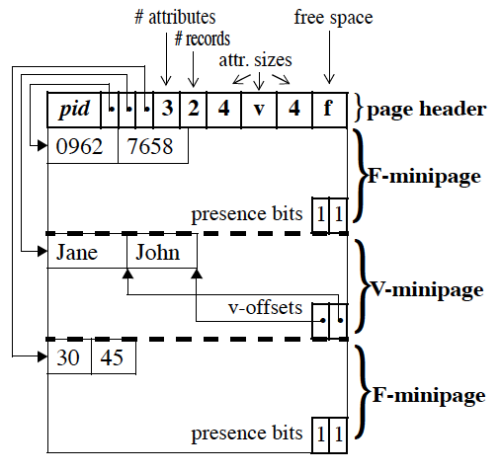
Partition Attributes Across (PAX)
Decompose a slotted-page internally in mini-pages per attribute
Cache-friendly
Compatible with slotted-pages
Retain NSM I/O pattern
No column “stitching”
No per-column tuple ids
Brings only relevant attributes to cache

Slide 54
PAX Americana
DSM most suitable for analytical queries, but required major rewrites of existing DBMS, and penalized transactions a lot.
PAX can replace NSM in-place
Oracle moved to PAX
So did most Hadoop-oriented file formats
Parquet
Arrow
…

Slide 55
Conclusion
File & Page layouts
Row stores
Transactions
Frequent inserts/updates/deletes
Column stores
Data analytics, data exploration
Mostly read-only data
Most queries access very few attributes
One size does not fit all: Different workloads require different storage layouts and data access methods

Slide 56
Reading material
Row stores: COW Book chapter 8 (material of CS322)
D. Abadi et al.: The Design and Implementation of Modern Column-Oriented Database Systems. Foundations and Trends in Databases, vol. 5, no. 3, pp. 227-263 only, 2013. Available online at: http://db.csail.mit.edu/pubs/abadi-column-stores.pdf
I. Alagiannis, S. Idreos, A. Ailamaki: H2O: A hands-free adaptive store. SIGMOD’14. Available online at: http://dl.acm.org/citation.cfm?doid=2588555.2610502
Optional readings
The remainder of: “The Design and Implementation of Modern Column-Oriented Database Systems”

